Slide 1
Bridging Gaps in Oncology
Cairo 2018
Husam Marashi
Consultant Clinical Oncologist
The Beatson West of Scotland cancer Centre
Glasgow / Scotland

Slide 2


The Beatson West of Scotland Cancer Centre

Slide 3

Breast Radiotherapy Trials
Past
Present
future

Slide 4
Breast Radiotherapy Trials
Past
Present
future
No worries
This talk will take 3 days

Slide 5
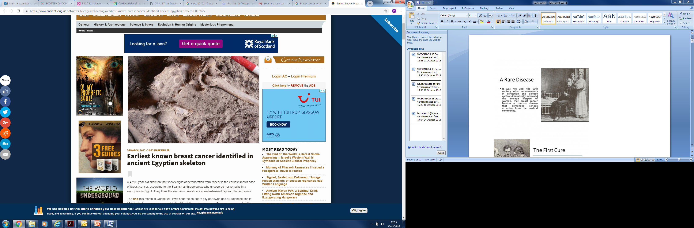
The PAST

Slide 6


Slide 7
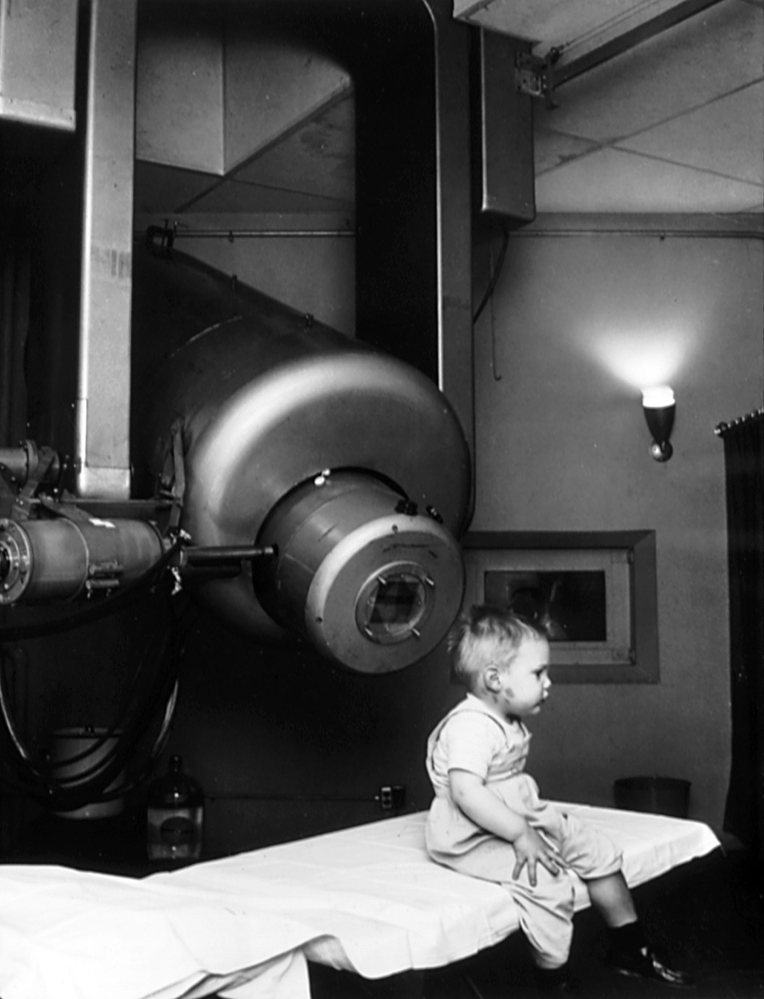
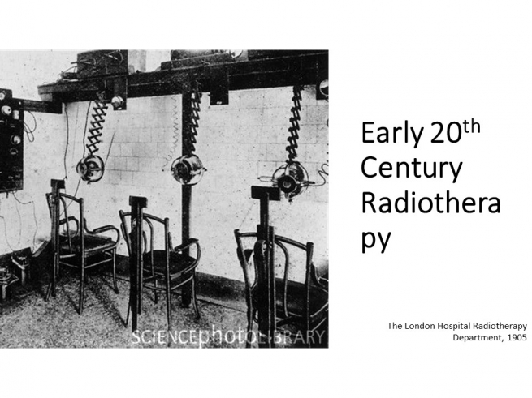
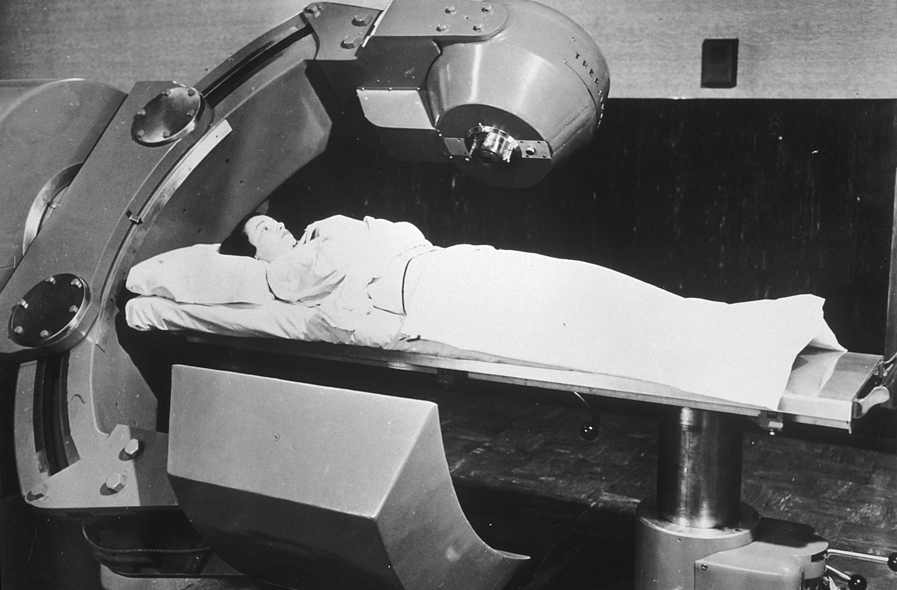
Radiotherapy
Stanford, 1957
The London Hospital, Radiotherapy Department,1905
Cobalt Teletherapy machine,1950

Slide 8
Radiotherapy Trials for Breast Cancer
Stage
Early
Value and toxicity
Radiotherapy or no Radiotherapy
volume
What to treat? WBRT Vs PBRT
Locally advanced
metastatic
Boost or no boost
Treating regional LN or not, IMN or Not
Modality
Technology
Photons, electrons or Protons
Methods of delivery radiations
Dose and Fractionation

Slide 9
Radiotherapy Trials for Breast Cancer
Stage
Early
Value and toxicity
Radiotherapy or no Radiotherapy
volume
What to treat? WBRT Vs PBRT
Locally advanced
metastatic
Boost or no boost
Treating regional LN or not, IMN or Not
Modality
Technology
Photons, electrons or Protons
Methods of delivery radiations
Dose and Fractionation

Slide 10
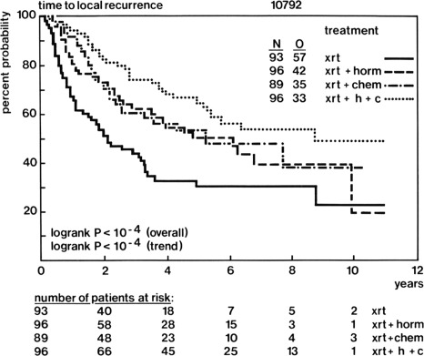
Radiotherapy value
EORTC 10792
Initiated 1979
Inoperable BC
410 patients
Notes:
(XRT alone) Vs (XRT+HT) Vs (XRT +CT) or all
Not influenced by age

Slide 11
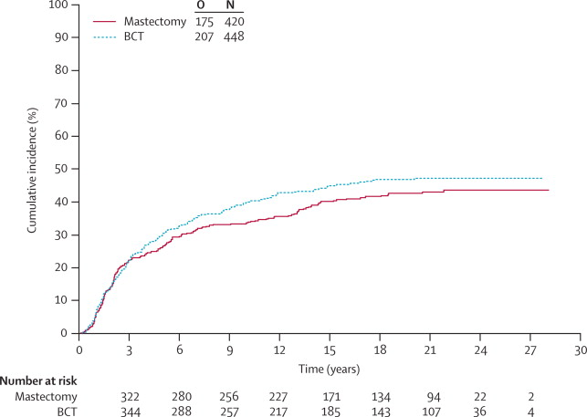
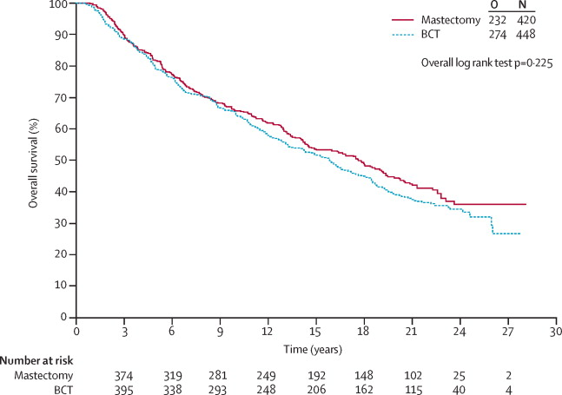
Radiotherapy value
Mastectomy Versus BCT
EORTC 10801
Initiated 1980
>=2cm or LN+ve(mostly stage II)
868 patients
BCT+XRT Vs MST
XRT= 50 Gy with 25Gy boost
Notes:
Mastectomy is the standard of treatment till 1980s regardless of stage of the disease
More data became available with the expertise from French radiotherapy centres led to exploration of BCT
High levels of LR in patients after BCT *Hayward et al, the Guy’s trial of tx of EBC Worl Jour of Surg 1977
But more favourable results for those with 2 cm or less
MST has better local control but not better OS
Better results in body image
The rate of distant metastases at 15 years was 39·0% for patients undergoing mastectomy and 43·5% for patients undergoing BCT
and at 20 years was 42·6% (37·8–47·5) in the mastectomy group and 46·9% (42·2–51·6) in the BCT group

Slide 12
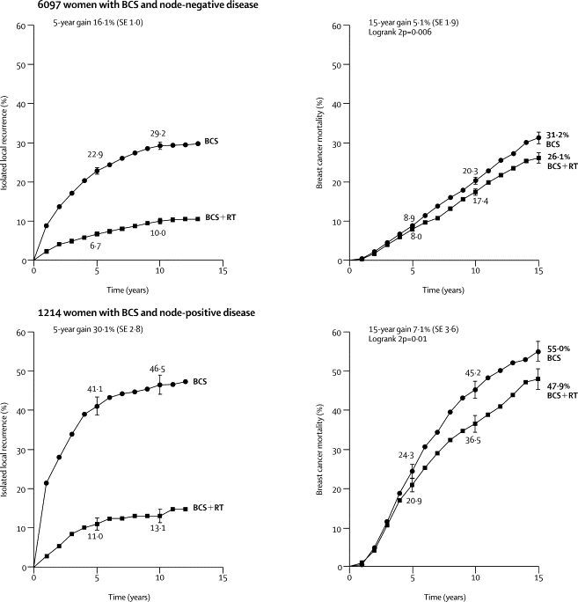
Meta-analysis EBCTCG
Clarke, Lancet 2005

Slide 13
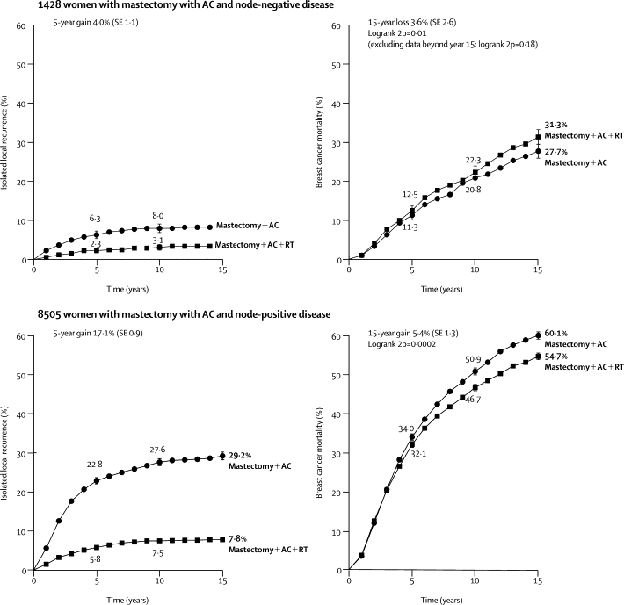
Meta-analysis EBCTCG
Clarke, Lancet 2005

Slide 14
^{Lancet 2005; 366: 2087–2106}
Notes:
These trials included all type of patients, older, younger, low risk and higher risk. All biological subtypes were included
In the current understanding of tu biology we know that breast cancer is heterogenious and one size fits all does not apply
The need to adapt radiotherapy to risk / biology and CMB is growing
Initial thoughts were directed at the need for radiotherapy altogether. Can we omit and if so, were do we start from.

Slide 15
Effect of radiotherapy after mastectomy and axillary surgery on 10-year recurrence and 20-year breast cancer mortality: meta-analysis of individual patient data for 8135 women in 22 randomised trials
EBCTCG (Early Breast Cancer Trialists’ Collaborative Group)* 2014
Notes:
effect of radiotherapy after mastectomy and axillary surgery on 10-year recurrence and 20-year breast cancer mortality: meta-analysis of individual patient data for 8135 women in 22 randomised trials

Slide 16
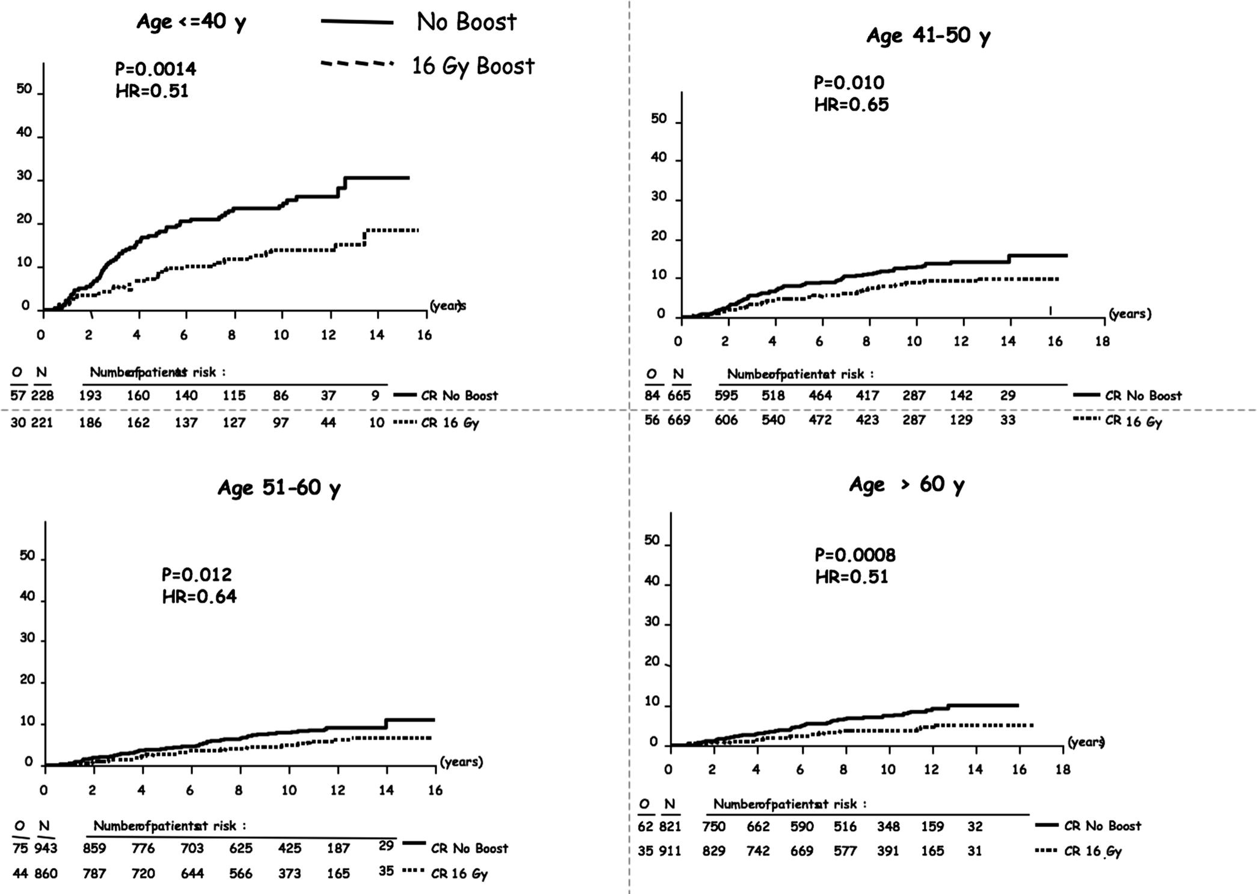
Boost VS no Boost
EORTC 22881
Those younger than 50 years profited from higher dose of XRT
Has no effect on long term overall survival
Increases risk of fibrosis (30 vs 15%)
Separate analysis for different pathological prognostic factors
Notes:
Boost dose of 25Gy??!!
Worse cosmesis outcome
50 Gy then boost of 16 Gy
>5000 patients

Slide 17
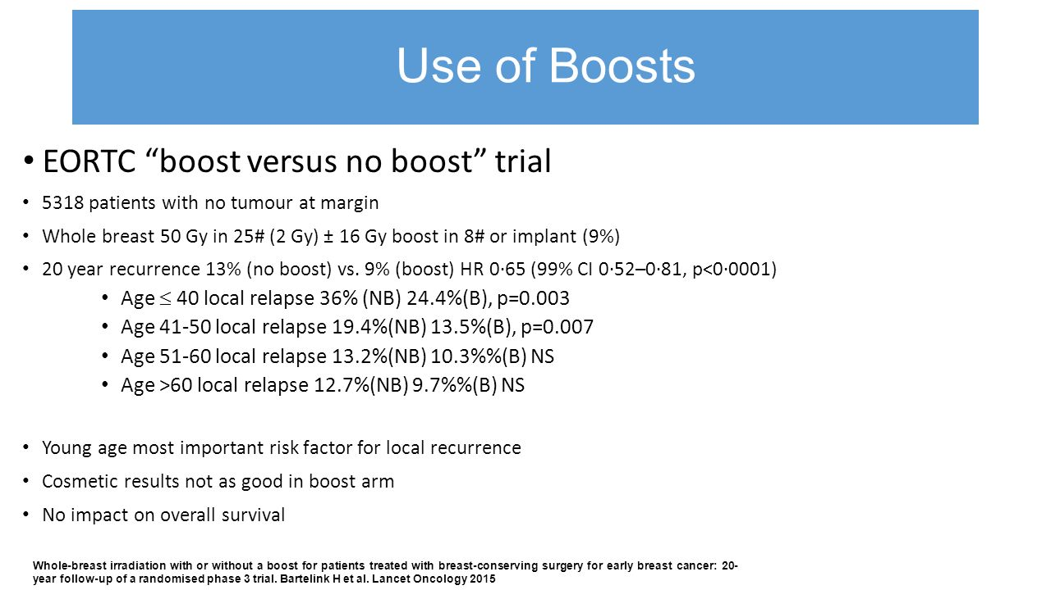

Slide 18
Young boost clinical trial
Control Arm
low dose boost (16 Gy)
Experimental Arm
high dose boost (26 Gy)
Local control at 10 yr
Cosmetic outcome
A. To test the genotypic and phenotypic profiles of breast tumors
a. Local recurrence after BCT
b. Lymph node metastases
c. Distant metastases and survival
d. Radiosensitivity
e. Age
B. To determine whether improved genotypic and phenotypic profiles can be determined related to the endpoints mentioned in A.

Slide 19
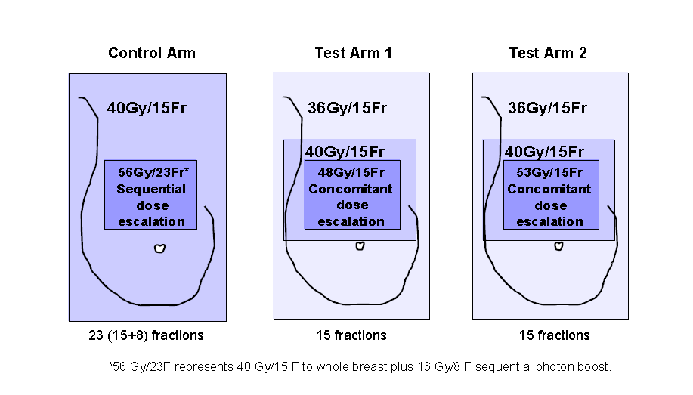
IMPORT-HIGH

Slide 20
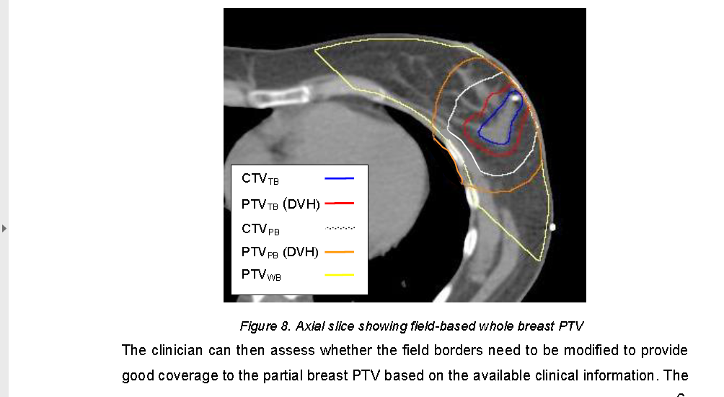
Randomised trial testing dose escalated intensity modulated radiotherapy for women treated by breast conservation surgery and appropriate systemic therapy for early breast cancer

Slide 21
Radiotherapy Trials for Breast Cancer
Stage
Early
Value and toxicity
Radiotherapy or no Radiotherapy
volume
What to treat? WBRT Vs PBRT
Locally advanced
metastatic
Boost or no boost
Treating regional LN or not, IMN or Not
Modality
Technology
Photons, electrons or Protons
Methods of delivery radiations
Dose and Fractionation

Slide 22
Radiotherapy Trials for Breast Cancer
Stage
Early
Value and toxicity
Radiotherapy or no Radiotherapy
volume
What to treat? WBRT Vs PBRT
Locally advanced
metastatic
Boost or no boost
Treating regional LN or not, IMN or Not
Modality
Technology
Photons, electrons or Protons
Methods of delivery radiations
Fractionation

Slide 23
Lumpectomy Plus Tamoxifen With or Without Irradiation in Women Age 70 Years or Older With Early Breast Cancer:
Long-Term Follow-Up of CALGB 9343
J Clin Oncol 31:2382-2387.
Notes:
Purpose
To determine whether there is a benefit to adjuvant radiation therapy after breast-conserving surgery and tamoxifen in women age 􏰁 70 years with early-stage breast cancer.
Patients and Methods
Between July 1994 and February 1999, 636 women (age 􏰁 70 years) who had clinical stage I (T1N0M0 according to TNM classification) estrogen receptor (ER) –positive breast carcinoma treated by lumpectomy were randomly assigned to receive tamoxifen plus radiation therapy (TamRT; 317 women) or tamoxifen alone (Tam; 319 women). Primary end points were time to local or regional recurrence, frequency of mastectomy, breast cancer–specific survival, time to distant metastasis, and overall survival (OS).
Results
Median follow-up for treated patients is now 12.6 years. At 10 years, 98% of patients receiving TamRT (95% CI, 96% to 99%) compared with 90% of those receiving Tam (95% CI, 85% to 93%) were free from local and regional recurrences. There were no significant differences in time to mastectomy, time to distant metastasis, breast cancer–specific survival, or OS between the two groups. Ten-year OS was 67% (95% CI, 62% to 72%) and 66% (95% CI, 61% to 71%) in the TamRT and Tam groups, respectively.
Conclusion
With long-term follow-up, the previously observed small improvement in locoregional recurrence with the addition of radiation therapy remains. However, this does not translate into an advantage in OS, distant disease-free survival, or breast preservation. Depending on the value placed on local recurrence, Tam remains a reasonable option for women age 􏰁 70 years with ER-positive early-stage breast cancer.

Slide 24
Breast-conserving surgery with or without irradiation in women aged 65 years or older with early breast cancer (PRIME II):
^{A randomised controlled trial}
Lancet Oncol 2015; 16: 266–73
Notes:
Background For most older women with early breast cancer, standard treatment after breast-conserving surgery is adjuvant whole-breast radiotherapy and adjuvant endocrine treatment. We aimed to assess the effect omission of whole-breast radiotherapy would have on local control in older women at low risk of local recurrence at 5 years.
Methods Between April 16, 2003, and Dec 22, 2009, 1326 women aged 65 years or older with early breast cancer judged low-risk (ie, hormone receptor-positive, axillary node-negative, T1–T2 up to 3 cm at the longest dimension, and clear margins; grade 3 tumour histology or lymphovascular invasion, but not both, were permitted), who had had breast- conserving surgery and were receiving adjuvant endocrine treatment, were recruited into a phase 3 randomised controlled trial at 76 centres in four countries. Eligible patients were randomly assigned to either whole-breast radiotherapy (40–50 Gy in 15–25 fractions) or no radiotherapy by computer-generated permuted block randomisation, stratified by centre, with a block size of four. The primary endpoint was ipsilateral breast tumour recurrence. Follow-up continues and will end at the 10-year anniversary of the last randomised patient. Analyses were done by intention to treat. The trial is registered on ISRCTN.com, number ISRCTN95889329.
Findings 658 women who had undergone breast-conserving surgery and who were receiving adjuvant endocrine treatment were randomly assigned to receive whole-breast irradiation and 668 were allocated to no further treatment. After median follow-up of 5 years (IQR 3·84–6·05), ipsilateral breast tumour recurrence was 1·3% (95% CI 0·2–2·3; n=5) in women assigned to whole-breast radiotherapy and 4·1% (2·4–5·7; n=26) in those assigned no radiotherapy (p=0·0002). Compared with women allocated to whole-breast radiotherapy, the univariate hazard ratio for ipsilateral breast tumour recurrence in women assigned to no radiotherapy was 5·19 (95% CI 1·99–13·52; p=0·0007). No differences in regional recurrence, distant metastases, contralateral breast cancers, or new breast cancers were noted between groups. 5-year overall survival was 93·9% (95% CI 91·8–96·0) in both groups (p=0·34). 89 women died; eight of 49 patients allocated to no radiotherapy and four of 40 assigned to radiotherapy died from breast cancer.
Interpretation Postoperative whole-breast radiotherapy after breast-conserving surgery and adjuvant endocrine treatment resulted in a significant but modest reduction in local recurrence for women aged 65 years or older with early breast cancer 5 years after randomisation. However, the 5-year rate of ipsilateral breast tumour recurrence is probably low enough for omission of radiotherapy to be considered for some patients.
Additional comment: it is worth noting that within the biologically favorable ERþ group, there may be patients with aggressive features whose risk of LRR is significantly higher than that of the group as a whole.

Slide 25
Optimal patient?
Low risk disease: <3cm G1-2, ER+, >65-70y
Comorbidities and competing medical conditions
Starting Adjuvant endocrine therapy for 5 years
Side-effects from Breast Radiotherapy May Now Outweigh Potential Benefit in Some Patients
Notes:
What about younger patients who have a low risk?
What if we have a favorable biology in a younger pt. is it safe to omit XRT
For example, the UK PRIME II trial
(2003e2009) reported a 5 year local relapse rate of 1.3% (95%
confidence interval 0.2e2.3) in low risk early breast cancer
patients (tumour 3 cm, oestrogen receptor positive, node
negative) after BCS and radiotherapy compared with 4.1%
(95% confidence interval 2.4e5.7) after no radiotherapy
(P ¼ 0.002)[2]. Therewas no excess of distant relapse, second
cancers or deaths, suggesting that local relapses after BCS
can be salvaged with further surgery ( radiotherapy)
without increasing the risk of breast cancer death. In an
unplanned subgroup analysis, oestrogen receptor-rich patients
receiving radiotherapy had only a 2.4% absolute gain in
local relapse over non-irradiated patients.

Slide 26
Int J Radiation Oncol Biol Phys, Vol. 100, No. 1, pp. 23e37, 2018
Notes:
Although much of the existing work has focused on the refinement of systemic therapy, data are also now available to describe the relationship between tumor biology and the risk of LRR.
there is also evidence that radiation response may be subtype-specific. Outcomes from the Oxford Early Breast Cancer Trialists’ Collaborative Group predating the routine use of targeted therapies show discrepancies in breast tumor radiation response, with estrogen receptor positive (ERþ) tumors seeming to derive a greater benefit from RT than their ER-poor counterparts

Slide 27
Notes:
The LUMINA study is a Canadian prospective multicenter cohort study of RT omission after BCS for patients aged !55 years with uni- focal stage I disease, grade 1 or 2, HRþ, HER2", and >13%); the trial opened in 2013 and expects to enroll 500 patients. Completed recruitment and in FU
IDEA study is a prospective multicenter cohort study of RT omission after BCS at 14 centers in the United States, led by the University of Michigan. The study includes patients aged 50 to 69 with unifocal stage I dis- ease, HRþ, HER2", and an Oncotype-DX recurrence score of 18; the trial opened in 2015 and expects to enroll 200 patients
PRECISION study is a prospective cohort study led by the Dana Farber Brigham and Women’s Hospital of patients aged 50 to 75 with unifocal stage I disease that is at least ERþ with a Prosigna PAM50 score of <40; the trial opened in 2016 and expects to enroll 345 patients

Slide 28
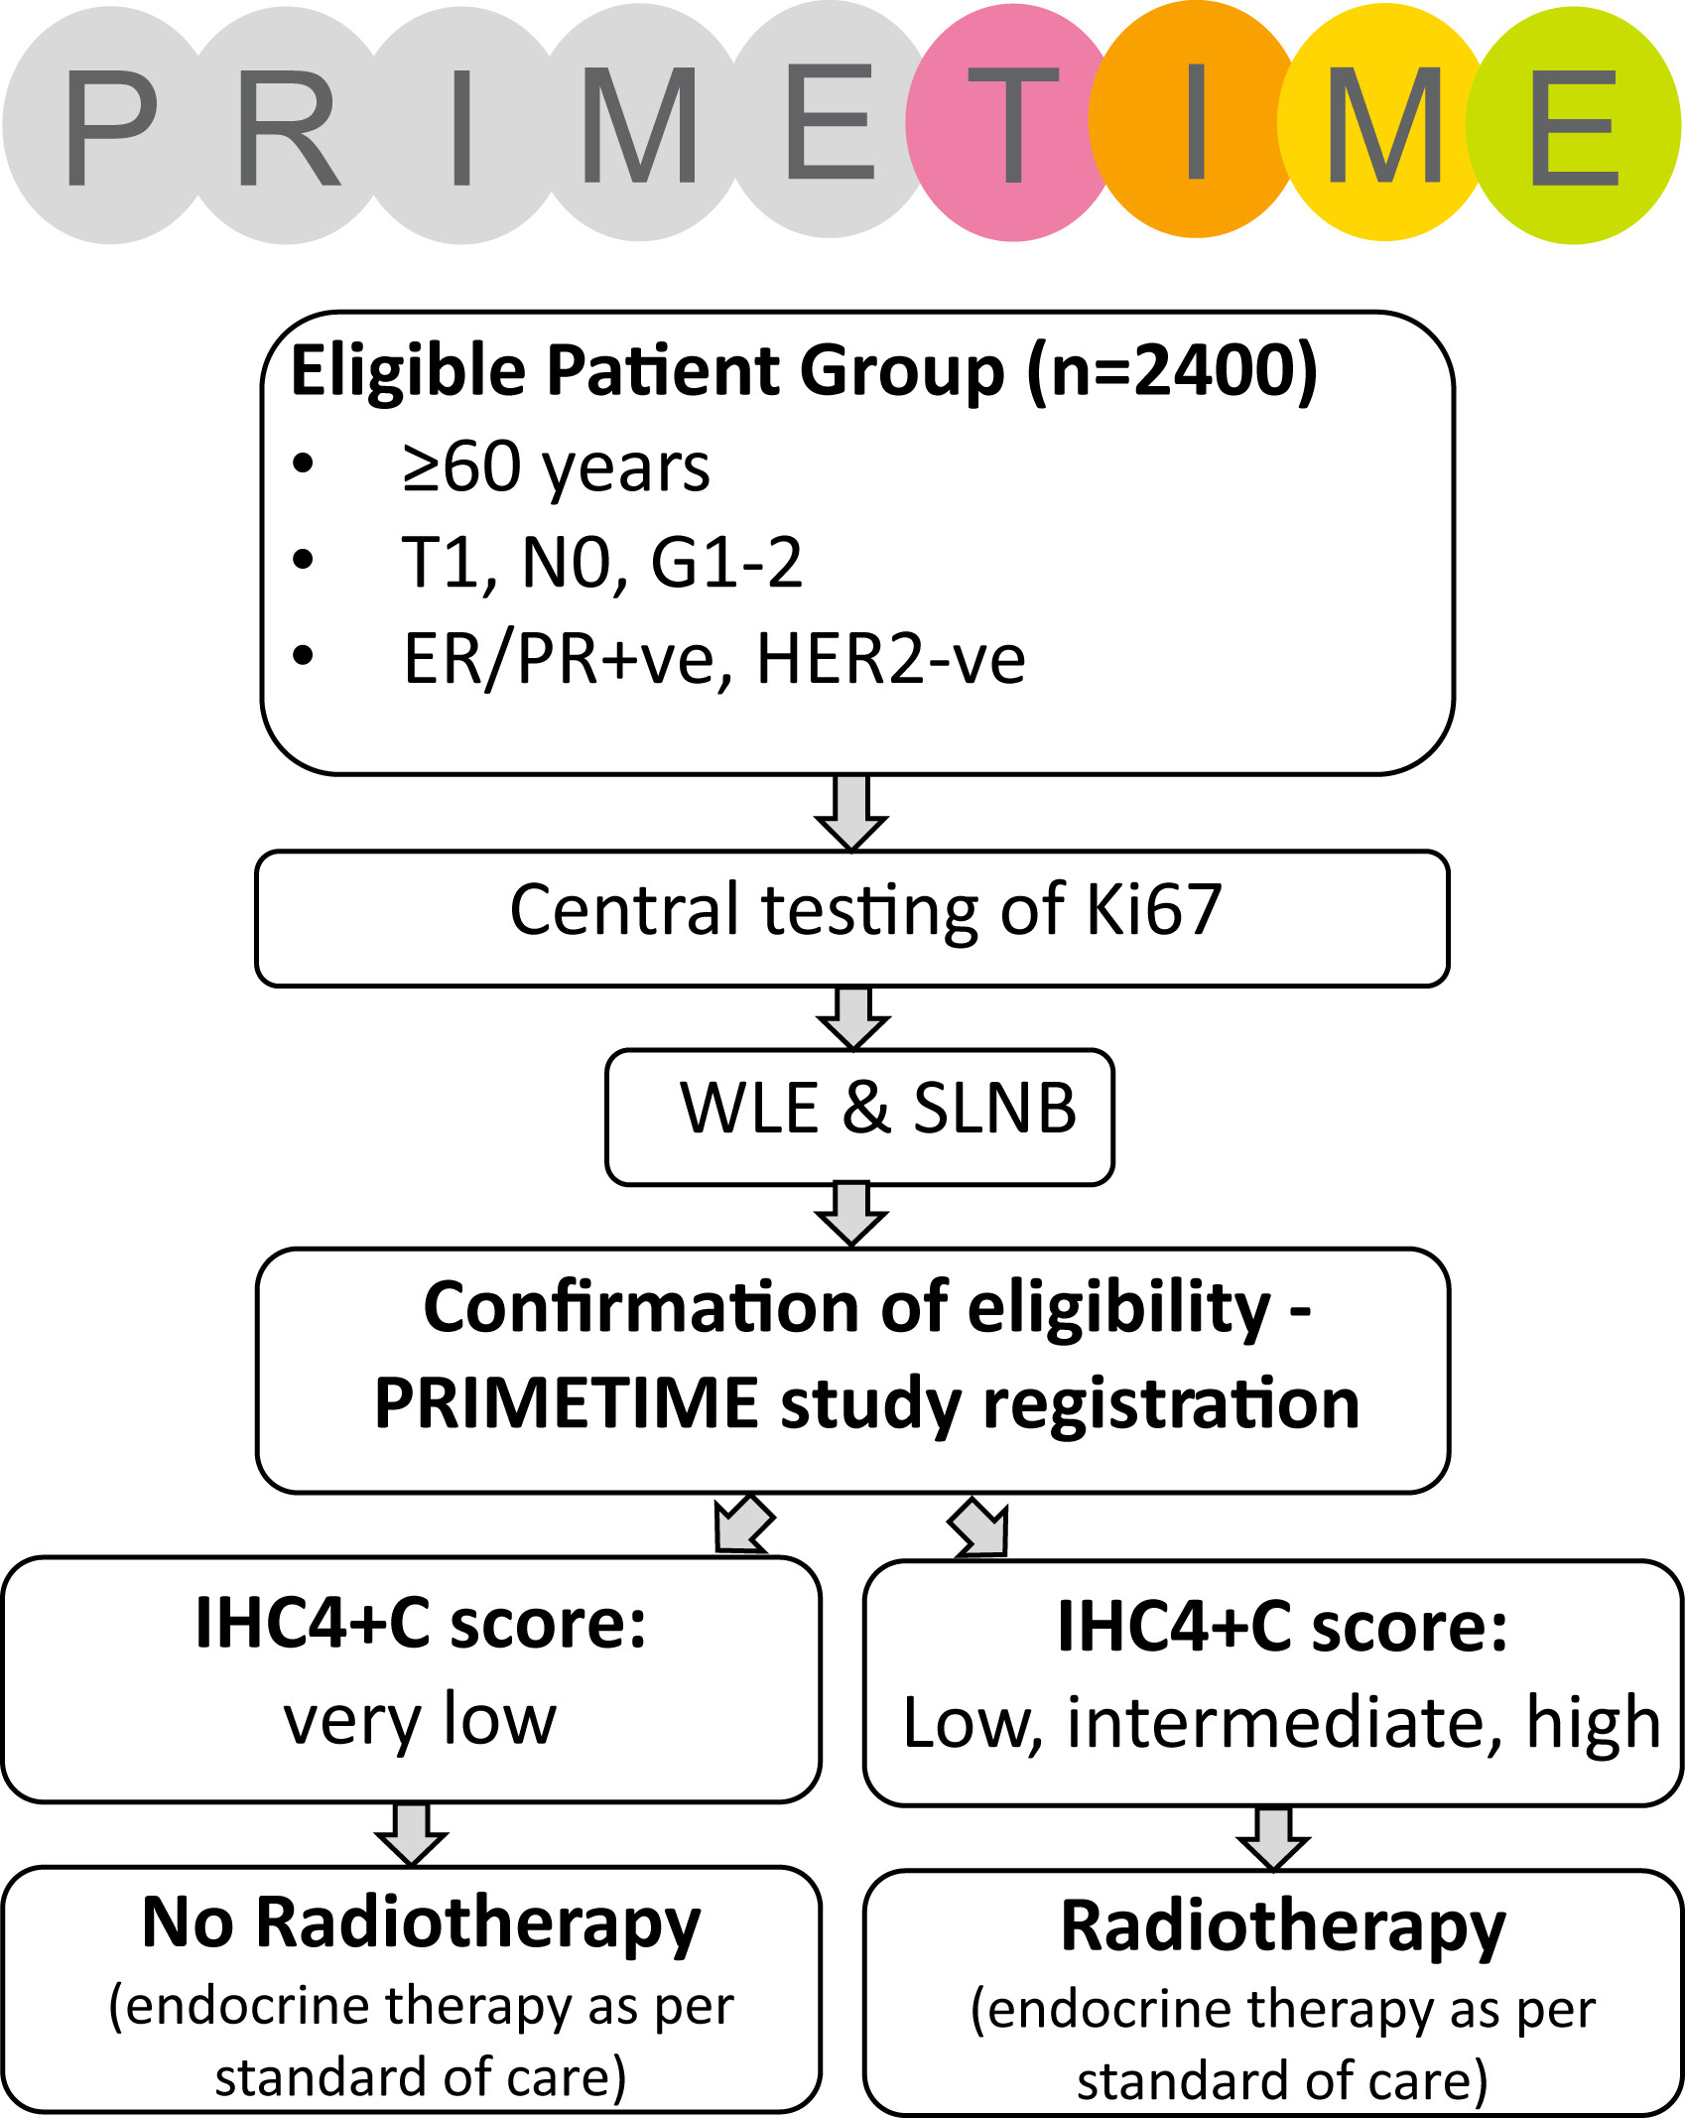
PRIMETIME is a prospective, biomarker-directed case cohort
study
Clinical Oncology 2016 28, 594-596DOI: (10.1016/j.clon.2016.06.007)
Notes:
The IHC4+C score is a prognostic tool that estimates the residual risk of distant recurrence at 10 years in post-menopausal women with ER-positive breast cancer who have received 5 years of endocrine therapy.
It incorporates both immunohistochemical parameters of ER, progesterone receptor (PgR), HER2 and Ki67 as well as the clinicopathological parameters of tumour size, grade, nodal status and type of endocrine therapy administered for 5 years (tamoxifen vs aromatase inhibitor).
It was developed from a retrospective analysis of 1125 patients with ER-positive disease from the TransATAC cohort who did not received chemotherapy, validated in an independent cohort of 786 patients and has been shown to perform similarly to the Genomic Health recurrence score (RS) in predicting distant recurrence (Cuzick et al, 2011). In this journal, Stephen et al, 2014 showed that in an endocrine treated population from the TEAM trial, the IHC4 provided stronger prognostic information when compared with the Mammostrat score.
PrimeTime study: The primary end point is ipsilateral breast disease rate at 5 years. PRIMETIME requires recruitment of 2400 patients at the preoperative stage, to allow 1550 patients to actively
avoid radiotherapy, based on a local relapse rate, in the absence of radiotherapy, of 4% at 5 years
the UK PRIME II trial
(2003e2009) reported a 5 year local relapse rate of 1.3% (95% confidence interval 0.2e2.3) in low risk early breast cancer patients (tumour 3 cm, oestrogen receptor positive, node negative) after BCS and radiotherapy compared with 4.1% (95% confidence interval 2.4e5.7) after no radiotherapy (P ¼ 0.002)[2]. Therewas no excess of distant relapse, second cancers or deaths, suggesting that local relapses after BCS can be salvaged with further surgery ( radiotherapy) without increasing the risk of breast cancer death. In an
unplanned subgroup analysis, oestrogen receptor-rich patients receiving radiotherapy had only a 2.4% absolute gain in local relapse over non-irradiated patients.
Side-effects after breast radiotherapy still occur with modern techniques, and the rates and severity are the same irrespective of the magnitude of radiotherapy benefit.
Australia/New Zealand (EXPERT, a randomized trial that will likely open in late 2017) women aged !50 years with stage I, biologically low-risk luminal A early-stage breast cancer (defined using the PAM50-based Prosigna assay) will be randomized to hormone therapy alone or RT plus hormone therapy

Slide 29
Partial breast irradiation
Institution/Trial | Target (yrs of accrual) | Control Arm | Experimental Arm
European Institute of Oncology ELIOT | 1200 (2000-2007) | WBI (50 Gy in 25 fx) ± 10 Gy Boost | IORT (21 Gy in 1 fx, using electrons up to 9 MeV)
TARGIT-A | 3451 (2000-2012) | WBI 40-56 Gy ± 10-16 Gy boost | IORT (20 Gy in 1 fx, low energy photon)
*NSABP B 39/RTOG 0413 | Closed to accrual 4/13; n=4216 | 50-50.4 Gy WBI ± 10-16 Gy Boost | (1) MIB (34 Gy in 10 fx), or (2) MammoSite™ (34 Gy in 10 fx) or (3) 3D-CRT (38.5 Gy in 10 fx)
French SHARE | 1170 (2004-2009) | WBI (50 Gy in 25 fx) + 16 Gy Boost WBI (40 Gy in 15 fx; or 42.5 in 16 fx) | 3d-CRT (40 Gy in 10 fx, BID)
Medical Research Council – UK IMPORT LOW | 1935 (2007-2010) | WB 2.67Gy X 15 | (1) WB 2.4Gy X 15 (2) PB 2.67Gy X 15 (3) PB only 2.67Gy X 15
*Ontario Clinical Oncology Group- Canadian Trial RAPID | 2128 (2006- 7/2011) | WBI ± 10 Gy boost: (1) 42.5 Gy in 16 fx for small breasts or (2) 50 Gy in 25 fx for large breasts | 3D CRT only (38.5 Gy in 10 fx)
GEC ESTRO Brachytherapy | 1184 (2004 - 2009 ) | WBI total dose of 50·0–50·4 Gy + boost 10Gy | Multicatheter BT 32 Gy / 8 f (bd) Or 30.3 Gy / 7 f (bd)
Notes:
Age and path inclusion criteria?

Slide 30
Brachytherapy
Breast conserving surgery, low risk“ breast cancer
1. Patients aged 40 years or older ,
2. pTis or pT1–2a (lesions of ≤ 3 cm diameter), pN0/pNmi and M0
3. Clear resection margins of at least 2 mm in any direction L0, V0, no EIC.
Stratification
Accelerated Partial Breast Irradiation
SOLE Multicatheter Brachytherapy
HDR: 8x 4.0 Gy, 7x 4.3 Gy
PDR: 0.6-0.8 Gy up to 50 Gy
Whole Breast Irradiation
(50 Gy + Boost 10 Gy)
April 2004 - July 2009, 1184 patients
n=633
n=551
Notes:
A prospective and randomized phase 3 trial
Non-inferiority trial
3% non-inferiority margin
Primary endpoint: Ipsilateral local recurrence
Analysis of results “as treated”

Slide 31
PATIENTS CHARACTERISTICS
 | APBI group (n=633) | WBI group (n=551) | p-value
Age
Age (years): median (range) | 62 ( 40 - 92) | 62 ( 40 - 85) | 0·86
Menopausal status: n (%)
premenopausal | 108 ( 17 ) | 92 ( 17 )
postmenopausal | 525 ( 83 ) | 459 ( 83 ) | 0.93
unknown | 0 ( 0 ) | 0 ( 0 )
Tumour size and resection margins
Tumor diameter (mm): median (range) | 12 ( 9 - 30 ) | 12 ( 9 – 30 ) | 0·19
Surgical free margins (mm): median (range) | 8 ( 2 - 40 ) | 7 ( 2 - 25 ) | 0·39
Grading: n (%)
G1 | 248 ( 39 ) | 217 ( 39 )
G2 | 319 ( 50 ) | 288 ( 52 ) | 0.55
G3 | 57 ( 9 ) | 42 (8 )
Systemic treatment: n (%)
yes | 572 (90) | 505 (92)
no | 59 ( 9 ) | 46 ( 8 ) | 0.63
Follow-up: 6.6 y. (median)
Notes:
Predominantly post menopausal, G1/2,

Slide 32
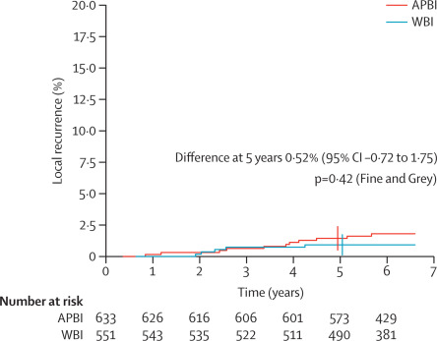
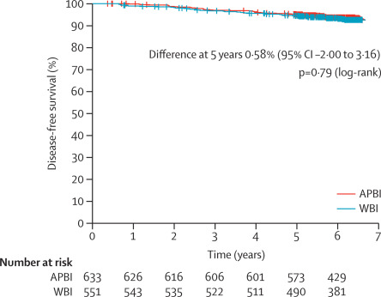
Ipsilateral Breast Recurrence
5-year results of accelerated partial breast irradiation using sole interstitial multicatheter brachytherapy versus whole-breast irradiation with boost after breast-conserving surgery for low-risk invasive and in-situ carcinoma of the female breast: a randomised, phase 3, non-inferiority trial
Disease-Free Survival
Lancet Oncology online October 20, 2015

Slide 33
partial breast irradiation
674 pt
673 pt
669 pt
^{The Lancet August 2, 2017}

Slide 35
partial breast irradiation
With a median follow-up of 5.8 years, the 5-year recurrence rates for ELIOT versus external beam radiation therapy (EBRT) patients were 4.4 % and 0.4 %, respectively, p = .0001.
Lancet Oncol. 2013;14:1269–77.
Notes:
Background Intraoperative radiotherapy with electrons allows the substitution of conventional postoperative whole breast irradiation with one session of radiotherapy with the same equivalent dose during surgery. However, its ability to control for recurrence of local disease required confirmation in a randomised controlled trial.
Methods This study was done at the European Institute of Oncology (Milan, Italy). Women aged 48–75 years with early breast cancer, a maximum tumour diameter of up to 2·5 cm, and suitable for breast-conserving surgery were randomly assigned in a 1:1 ratio (using a random permuted block design, stratified for clinical tumour size [<1·0 cm vs 1·0–1·4 cm vs ≥1·5 cm]) to receive either whole-breast external radiotherapy or intraoperative radiotherapy with electrons. Study coordinators, clinicians, and patients were aware of the assignment. Patients in the intraoperative radiotherapy group received one dose of 21 Gy to the tumour bed during surgery. Those in the external radiotherapy group received 50 Gy in 25 fractions of 2 Gy, followed by a boost of 10 Gy in five fractions. This was an equivalence trial; the prespecified equivalence margin was local recurrence of 7·5% in the intraoperative radiotherapy group. The primary endpoint was occurrence of ipsilateral breast tumour recurrences (IBTR); overall survival was a secondary outcome. The main analysis was by intention to treat. This trial is registered with ClinicalTrials.gov, number NCT01849133.
Findings 1305 patients were randomised (654 to external radiotherapy and 651 to intraoperative radiotherapy) between Nov 20, 2000, and Dec 27, 2007. After a medium follow-up of 5·8 years (IQR 4·1–7·7), 35 patients in the intraoperative radiotherapy group and four patients in the external radiotherapy group had had an IBTR (p<0·0001). The 5-year event rate for IBRT was 4·4% (95% CI 2·7–6·1) in the intraoperative radiotherapy group and 0·4% (0·0–1·0) in the external radiotherapy group (hazard ratio 9·3 [95% CI 3·3–26·3]). During the same period, 34 women allocated to intraoperative radiotherapy and 31 to external radiotherapy died (p=0·59). 5-year overall survival was 96·8% (95% CI 95·3–98·3) in the intraoperative radiotherapy group and 96·9% (95·5–98·3) in the external radiotherapy group. In patients with data available (n=464 for intraoperative radiotherapy; n=412 for external radiotherapy) we noted significantly fewer skin side-effects in women in the intraoperative radiotherapy group than in those in the external radiotherapy group (p=0·0002).
Interpretation Although the rate of IBTR in the intraoperative radiotherapy group was within the prespecified equivalence margin, the rate was significantly greater than with external radiotherapy, and overall survival did not differ between groups. Improved selection of patients could reduce the rate of IBTR with intraoperative radiotherapy with electrons.
Comments: the need for longer follow-up and outline the importance of proper selection of patients. Failure of local control was partly attributable to ipsilateral events in sites other than the index quadrant.

Slide 36
partial breast irradiation
The 5-year risk for local recurrence in the conserved breast was 3·3% (95% CI 2·1–5·1) for TARGIT versus 1·3% (0·7–2·5) for EBRT (p=0·042)
^{Lancet 2014; 383: 603–13}
Notes:
Background The TARGIT-A trial compared risk-adapted radiotherapy using single-dose targeted intraoperative radiotherapy (TARGIT) versus fractionated external beam radiotherapy (EBRT) for breast cancer. We report 5-year results for local recurrence and the first analysis of overall survival.
Methods TARGIT-A was a randomised, non-inferiority trial. Women aged 45 years and older with invasive ductal carcinoma were enrolled and randomly assigned in a 1:1 ratio to receive TARGIT or whole-breast EBRT, with blocks stratified by centre and by timing of delivery of targeted intraoperative radiotherapy: randomisation occurred either before lumpectomy (prepathology stratum, TARGIT concurrent with lumpectomy) or after lumpectomy (postpathology stratum, TARGIT given subsequently by reopening the wound). Patients in the TARGIT group received supplemental EBRT (excluding a boost) if unforeseen adverse features were detected on final pathology, thus radiotherapy was risk-adapted. The primary outcome was absolute difference in local recurrence in the conserved breast, with a prespecified non-inferiority margin of 2·5% at 5 years; prespecified analyses included outcomes as per timing of randomisation in relation to lumpectomy. Secondary outcomes included complications and mortality. This study is registered with ClinicalTrials.gov, number NCT00983684.
Findings Patients were enrolled at 33 centres in 11 countries, between March 24, 2000, and June 25, 2012. 1721 patients were randomised to TARGIT and 1730 to EBRT. Supplemental EBRT after TARGIT was necessary in 15·2% [239 of 1571] of patients who received TARGIT (21·6% prepathology, 3·6% postpathology). 3451 patients had a median follow-up of 2 years and 5 months (IQR 12–52 months), 2020 of 4 years, and 1222 of 5 years.
The 5-year risk for local recurrence in the conserved breast was 3·3% (95% CI 2·1–5·1) for TARGIT versus 1·3% (0·7–2·5) for EBRT (p=0·042). TARGIT concurrently with lumpectomy (prepathology, n=2298) had much the same results as EBRT: 2·1% (1·1–4·2) versus 1·1% (0·5–2·5; p=0·31). With delayed TARGIT (postpathology, n=1153) the between-group difference was larger than 2·5% (TARGIT 5·4% [3·0–9·7] vs EBRT 1·7% [0·6–4·9]; p=0·069).
Overall, breast cancer mortality was much the same between groups (2·6% [1·5–4·3] for TARGIT vs 1·9% [1·1–3·2] for EBRT; p=0·56) but there were significantly fewer non-breast-cancer deaths with TARGIT (1·4% [0·8–2·5] vs 3·5% [2·3–5·2]; p=0·0086), attributable to fewer deaths from cardiovascular causes and other cancers. Overall mortality was 3·9% (2·7–5·8) for TARGIT versus 5·3% (3·9–7·3) for EBRT (p=0·099). Wound-related complications were much the same between groups but grade 3 or 4 skin complications were significantly reduced with TARGIT (four of 1720 vs 13 of 1731, p=0·029).
Interpretation TARGIT concurrent with lumpectomy within a risk-adapted approach should be considered as an option for eligible patients with breast cancer carefully selected as per the TARGIT-A trial protocol, as an alternative to postoperative EBRT.

Slide 37
B-39/RTOG 0413
A Randomized Phase III Study of Conventional Whole Breast Irradiation (WBI) Versus Partial Breast Irradiation (PBI) for Women with Stage 0, I, or II Breast Cancer
Notes:
Study Type : Interventional (Clinical Trial)
Actual Enrollment : 4216 participants
Allocation: Randomized
Intervention Model: Parallel Assignment
Masking: None (Open Label)
Primary Purpose: Treatment
Official Title: A Randomized Phase III Study of Conventional Whole Breast Irradiation (WBI) Versus Partial Breast Irradiation (PBI) for Women With Stage 0, I, or II Breast Cancer
Study Start Date : March 2005
Estimated Primary Completion Date : April 2018
Estimated Study Completion Date : April 2020

Slide 38
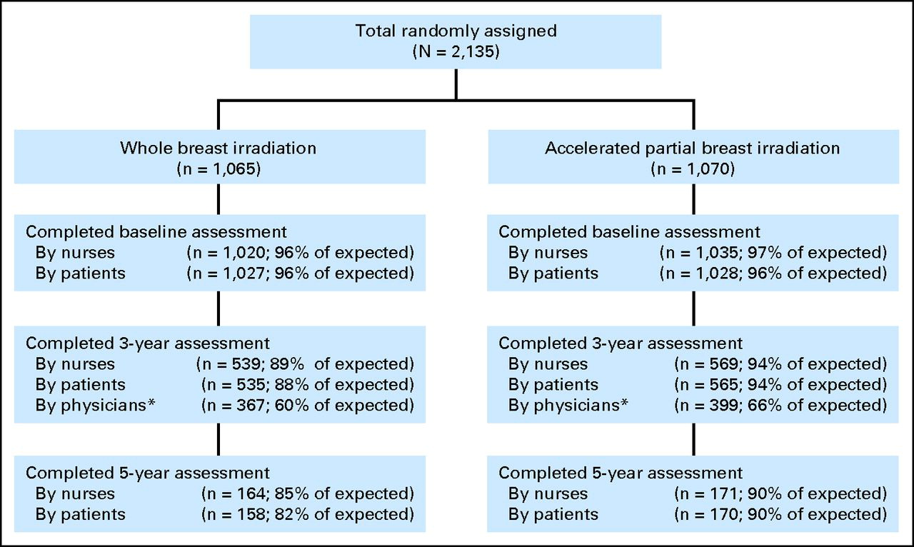
JCO VOLUME 31 􏰈 NUMBER 32 􏰈 NOVEMBER 10 2013
Notes:
RAPID Canadian trial
Purpose
To report interim cosmetic and toxicity results of a multicenter randomized trial comparing accelerated partial-breast irradiation (APBI) using three-dimensional conformal external beam radiation therapy (3D-CRT) with whole-breast irradiation (WBI).
Patients and Methods
Women age 􏰀 40 years with invasive or in situ breast cancer 􏰅 3 cm were randomly assigned after breast-conserving surgery to 3D-CRT APBI (38.5 Gy in 10 fractions twice daily) or WBI (42.5 Gy in 16 or 50 Gy in 25 daily fractions 􏰁 boost irradiation). The primary outcome was ipsilateral breast tumor recurrence (IBTR). Secondary outcomes were cosmesis and toxicity. Adverse cosmesis was defined as a fair or poor global cosmetic score. After a planned interim cosmetic analysis, the data, safety, and monitoring committee recommended release of results. There have been too few IBTR events to trigger an efficacy analysis.
Results
Between 2006 and 2011, 2,135 women were randomly assigned to 3D-CRT APBI or WBI. Median follow-up was 36 months. Adverse cosmesis at 3 years was increased among those treated with APBI compared with WBI as assessed by trained nurses (29% v 17%; P 􏰂 .001), by patients (26% v 18%; P 􏰃 .0022), and by physicians reviewing digital photographs (35% v 17%; P 􏰂 .001). Grade 3 toxicities were rare in both treatment arms (1.4% v 0%), but grade 1 and 2 toxicities were increased among those who received APBI compared with WBI (P 􏰂 .001).
Conclusion
3D-CRT APBI increased rates of adverse cosmesis and late radiation toxicity compared with standard WBI. Clinicians and patients are cautioned against the use of 3D-CRT APBI outside the context of a controlled trial.

Slide 39
NCCN Guidelines Version 2.2017
APBI guidelines
Patients who may be suitable for APBI are
1. women 60 years of age and older
^{2.} Not carriers of a known BRCA1/2 mutation
3. Have been treated with primary surgery for a unifocal stage I, ER-positive cancer.
4. Tumors should be infiltrating ductal or have a favorable histology
^{5.} Should not be associated with an extensive intraductal component or LCIS
^{6.} ^{Negative margins.}
34 Gy in 10 fractions delivered twice per day with brachytherapy
38.5 Gy in 10 fractions delivered twice per day with external beam photon therapy to the tumor bed is recommended.
Other fractionation schemes are under investigation

Slide 41
ESMO 2015

Slide 43
Radiotherapy Trials for Breast Cancer
Stage
Early
Value and toxicity
Radiotherapy or no Radiotherapy
volume
What to treat? WBRT Vs PBRT
Locally advanced
metastatic
Boost or no boost
Treating regional LN or not, IMN or Not
Modality
Technology
Photons, electrons or Protons
Methods of delivery radiations
Fractionation

Slide 44
Whole breast Hypofractionated irradiation
WB HFI

Slide 45
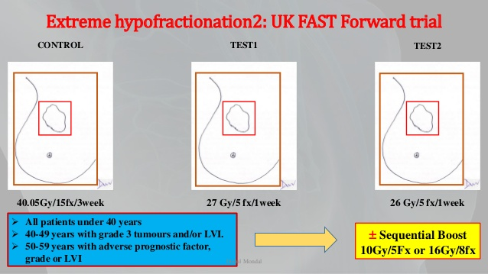

Slide 46
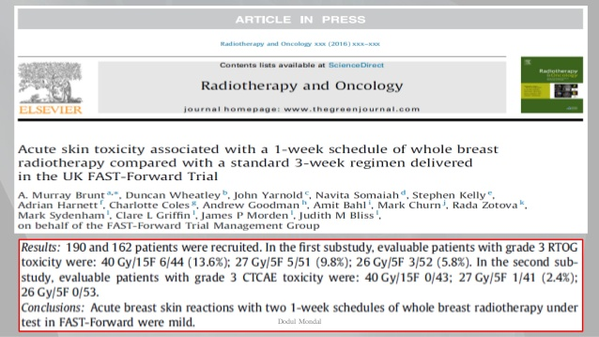

Slide 47
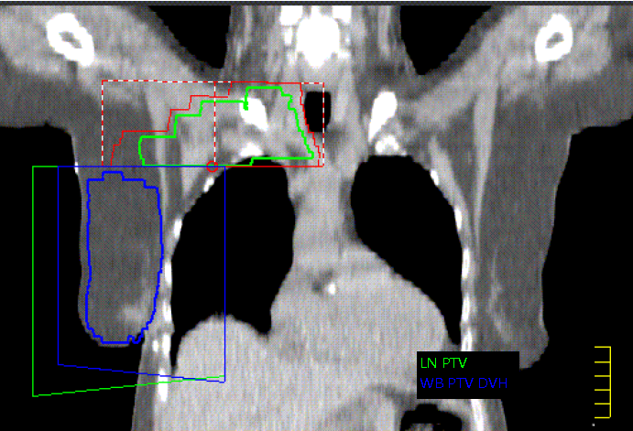
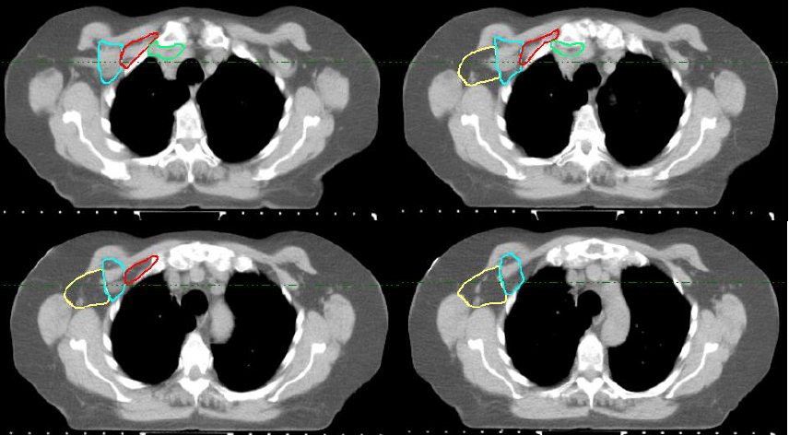
Fast Forward sub-study
Implementing ESTRO nodal outlining consensus guidelines
CT landmarks for the breast nodal groups (Adapted from Offeren et al, 2015)

Slide 48
Radiotherapy Trials for Breast Cancer
Stage
Early
Value and toxicity
Radiotherapy or no Radiotherapy
volume
What to treat? WBRT Vs PBRT
Locally advanced
metastatic
Boost or no boost
Treating regional LN or not, IMN or Not
Modality
Technology
Photons, electrons or Protons
Methods of delivery radiations
Fractionation

Slide 49
EORTC 22922
Compared RNI vs No RNI
4004 pt with 11 y median FU
Included LN +ve and LN –ve
Included Mx and WLE
Notes:
If SNB +ve, cANC is carried out
99% of LN +ve had systemic chemo
No excess cardiac deaths
Main cause of death was breast cancer
More pt had 2ndary cancer in the control arm (222 vs 191)
All pt benefited including LN -ve

Slide 50
MA 20
Compared RNI vs No RNI
1832 pts
Median FU 10 y
WLE and AND
Notes:
Inclusion: > 5cm or >2cm with G3/LVI/ER-ve
10% LN –ve
75 % 1-2 LN+ve

Slide 51
Danish Population study
3089 pt
RT vs Lt
WLE or Mx + AND
Median FU 9 y
Notes:
OS improved S
IHD similar in both groups

Slide 52
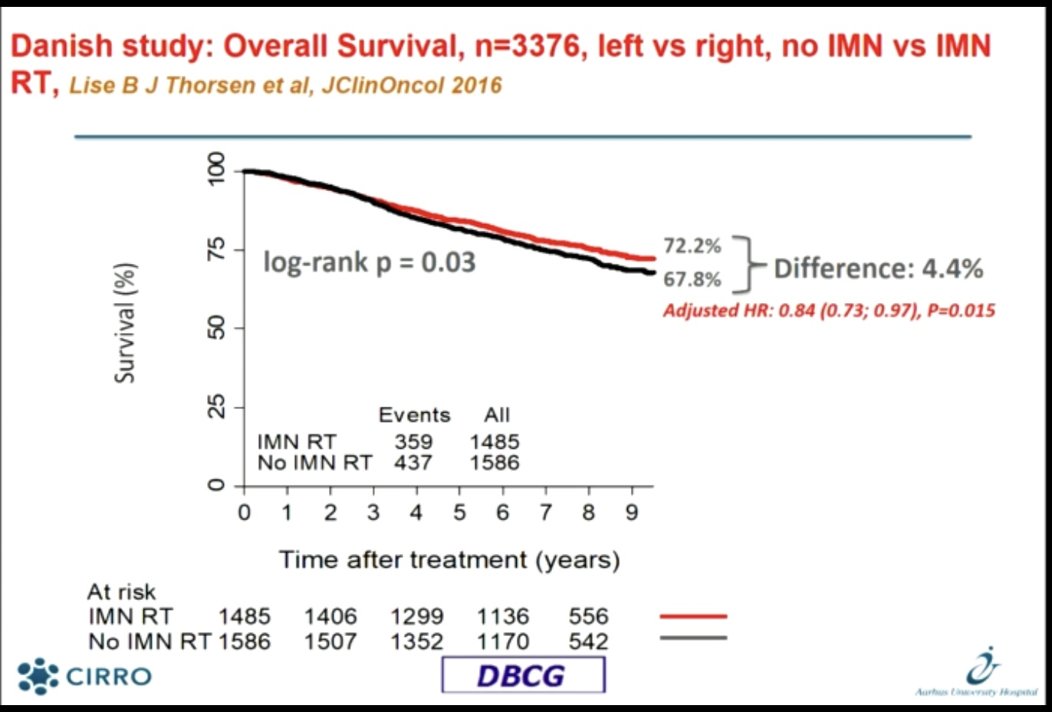

Slide 53
ACOSOG Z11
A randomized trial of axillary node dissection in women with clinical T1-2 N0 M0 breast cancer who have a positive SN.
Inclusion Exclusion
Clinical T1 T2 N0 breast cancer
H&E-detected metastases in SN (AJCC 5th edition)
Lumpectomy with whole breast irradiation
Adjuvant systemic therapy by choice
Third field (nodal), irradiation
Metastases in SN detected by IHC only
Matted nodes
3 or more involved SN
Giuliano A, JAMA 2011;305:589

Slide 54
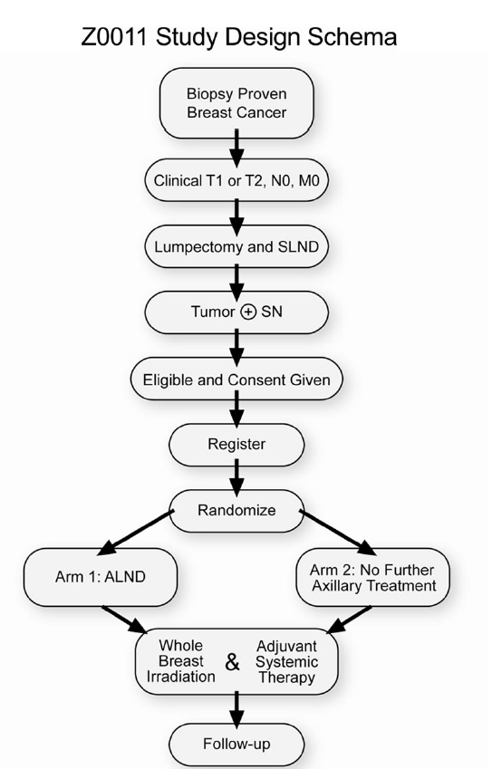
891 / 1900 pts
May 99 - Dec 04
cT1 70%
ER+ 83%
G1/2 70%
Systemic therapy 96%
420 pts
436 pts
Notes:
Study arms are well balanced in terms of patients and tumour characteristics as well as from Chemotherapy treatment point
The trial design was based on 5 y survival of 80% (too low) and that SNB arm will not be inferior by more than 5% (ie 75% at 5 years). Aiming for 1900 pt recruitment.
Low risk over all as 40% of SNB+ were micromets. 37% of ALND and 44% of SNB LN were micromets (0.2-2mm).
Average no of LN removed were 17 in ALND and 2 in SNB groups
Average no of +ve LN is 1 in ALND and 1 in SNB groups
27% of patients had further nodal disease in the ALND group.

Slide 55
Z11 outcomes
 | ALND (420) | SN (436)
LOCAL | 15 (3.6%) | 8 (1.8%)
REGIONAL | 2 (0.5%) | 4 (0.9%)
TOTAL | 17 (4.1%) | 12 (2.8%)
 | ALND | SN
% DFS | 82.2 (78.3-86.3%) | 83.9 (80.2-87.9%)
% OS | 91.8 (89.1-94.5%) | 92.5 (90-95.1%)
Morbidity outcome
 | ALND | SN
Wound infection/seroma | 70% | 25%
Lymphedema
Notes:
Z0011 is not the only study questioning ALND (NSABP B04, Martelli, Veronesi, Louis‐Sylvestre) In fact, no advantage to ALND has ever been definitely shown in prospective, randomized trials
WHAT ARE THE EXPLAINATIONS for this:
Systemic therapy is likely to be a factor but not the whole story. We know that in NACT only 20-25% of pts achieve pCR but 75-80% will not. The non SNB +ve LN in the cALND arm was 27% so likely that chemo might have been responsible for 5-6%. Also 2005 Metaanalysis confirm that systemic therapy reduces Local recurrences by 30-50%.
The other explanation is the role of Radiotherapy.

Slide 56
Radiation oncology aspects of Z11
No QA program for radiation aspect of the trial !!
Trial Protocol: No specific Axillary radiotherapy (No third field) allowed.
3rd fields is not the only way to deliver radiation dose to the axilla.
Highly likely that Axilla has been treated in these patients with alternative techniques. (High Tangents / extended high Tangents). Axillary coverage is likely to be similar to what we do here anyway. (TBC)
177 recruiting centres with no QA program is a major defect.
Potential bias toward larger fields in the SNB arm

Slide 57
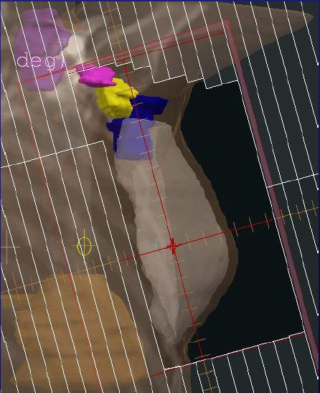
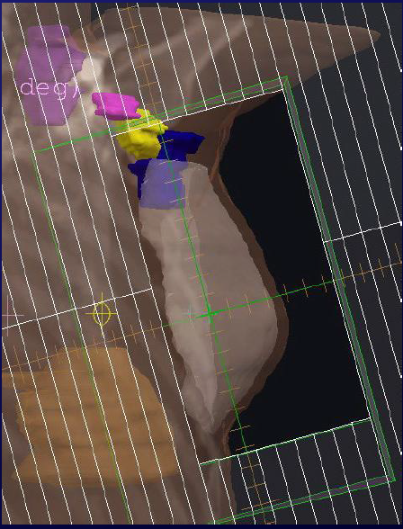
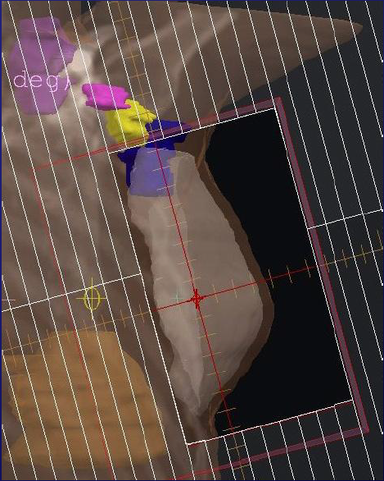
Customised high tangents
high
tangents
Standard tangents
Int. J. Radiation Oncology Biol. Phys., Vol. 61, No. 1, pp. 163–168, 2005

Slide 58
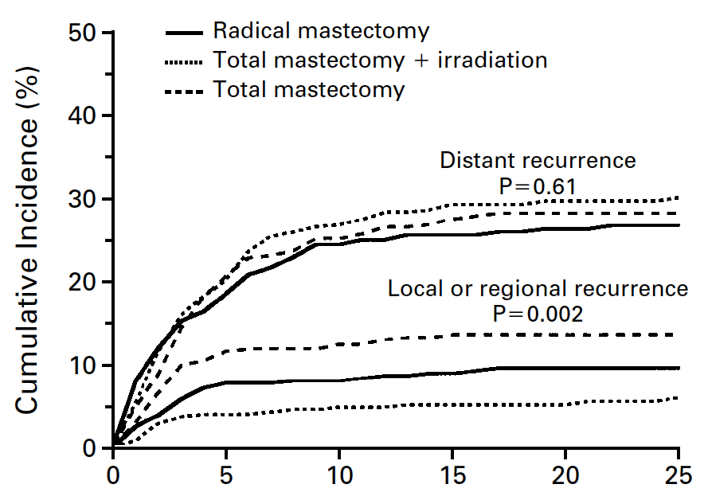
Lessons from other trials
Radiation is as effective as ALND
in cNo early breast cancer
Cumulative Incidence of Local or Regional Recurrence and Distant Recurrence during 25 Years of Follow-up after Surgery among Women with Clinically Negative Axillary Nodes
N Engl J Med 2002;347:567-575
Notes:
The success of Regional irradiation in eradicating and controlling regional disease has been well established.
40 % OF PTS had pN+ in the radical Mx arm
19% developed pN+ in the total Mx arm.

Slide 59
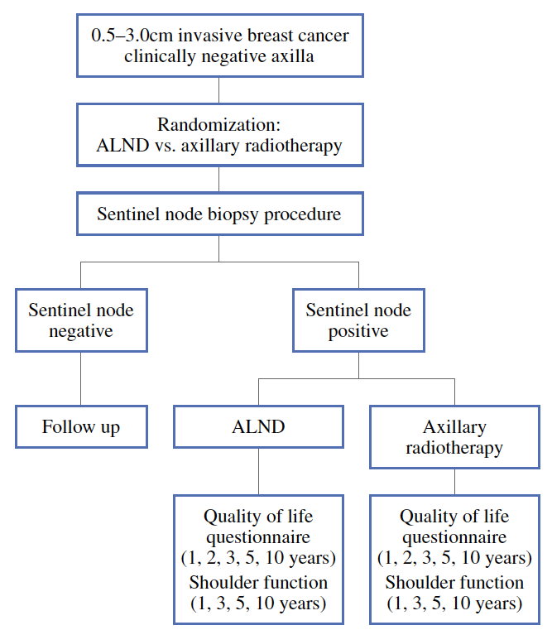
Lessons from other trials
AMAROS trial
Full QA program established
Recommended 3-4 fields treatment
Notes:
EORTC 10981-22023 AMAROS trial. Trial closed in June 2010
Sentinel node–positive patients allocated to the ART arm were irradiated within 12 weeks after surgery. All three levels of the axilla together with the medial part of the supraclavicular fossa were considered clinical the target volume. The prescribed dose to the axilla as a whole was 50 Gy in 25 fractions of 2 Gy in 5 weeks. All institutions documented their techniques for axillary irradiation on a dummy run that was evaluated by the radiotherapy quality assurance team before their participation was allowed.10 Postoperative axillary irradiation in patients undergoing ALND was allowed in patients with four or more tumor positive nodes (pN2 or pN3) and was applied according to institutional protocols.

Slide 60
Far less data for those having NACT

Slide 61
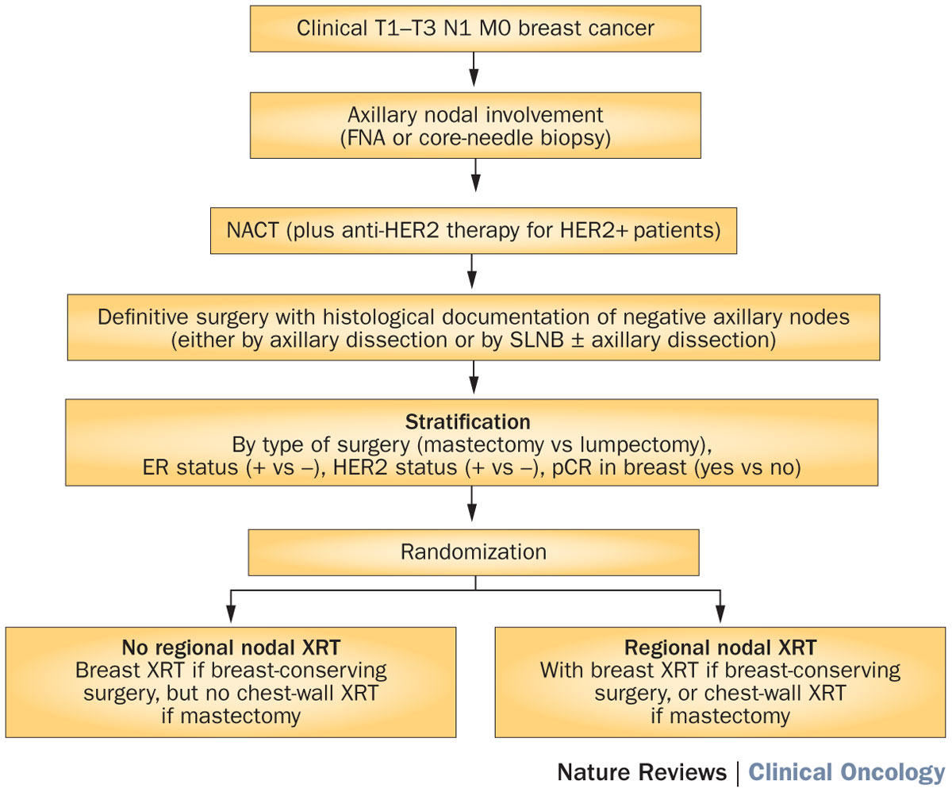
Figure 2 NSABP B‑51/RTOG 1304 (NRG 9353) trial schema
Prospective data addressing the need for radiotherapy after nodal pCR
King, T. A. & Morrow, M. (2015) Surgical issues in patients with breast cancer receiving neoadjuvant chemotherapy
Nat. Rev. Clin. Oncol. doi:10.1038/nrclinonc.2015.63

Slide 62
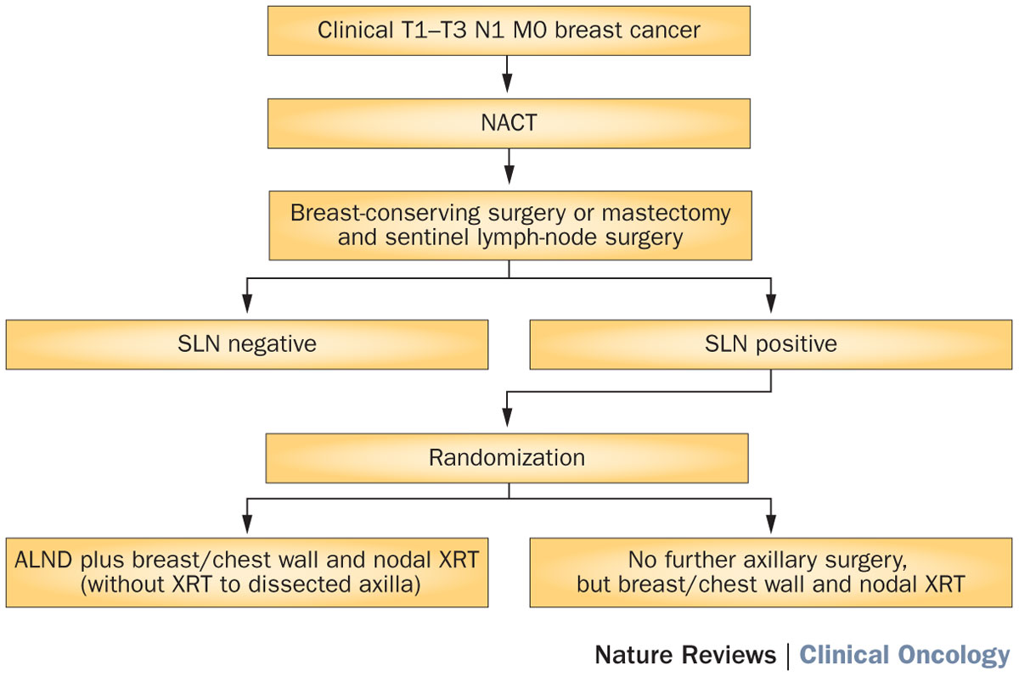
Figure 1 Alliance for Clinical Trials in Oncology A11202 trial schema
King, T. A. & Morrow, M. (2015) Surgical issues in patients with breast cancer receiving neoadjuvant chemotherapy
Nat. Rev. Clin. Oncol. doi:10.1038/nrclinonc.2015.63

Slide 63
Opposing trends in axilla management
SURGERY
more
less
RADIOTHERAPY
MA20 EORTC 22922 DANISH TRIAL | AMAROS | IBCSG 23-01 Z0011

Slide 64
Need for better risk stratification is evaluated in RCT
uN0 | Pn1(1-2 LN) |  | cN1 ypN1
SOUND INSEMA | POSNOC CHINA_Z11 FRANCE Z11 | ALLIANCE AO11202 SENOMAC | TAXIS

Slide 65
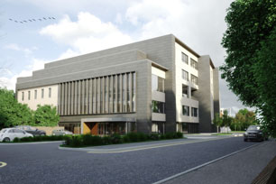
Protons centre in Manchester

Slide 66
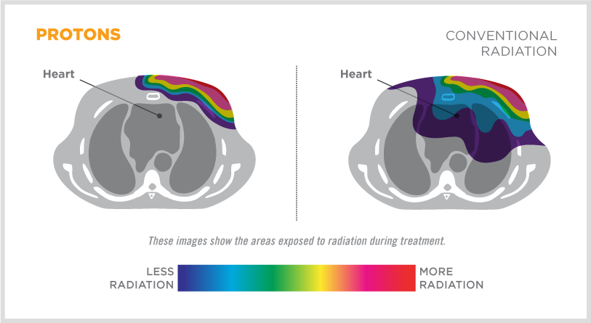

Slide 67
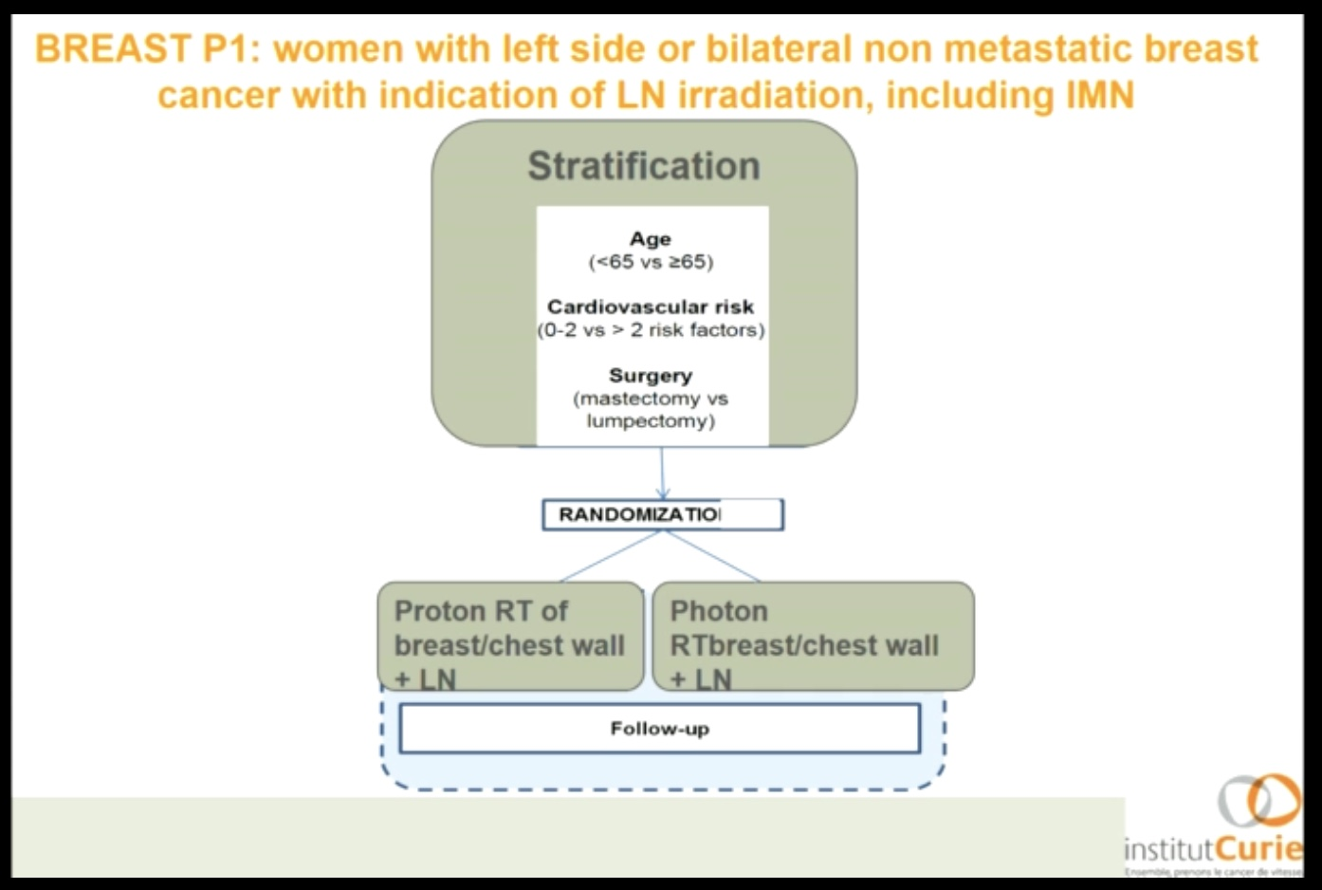

Slide 68
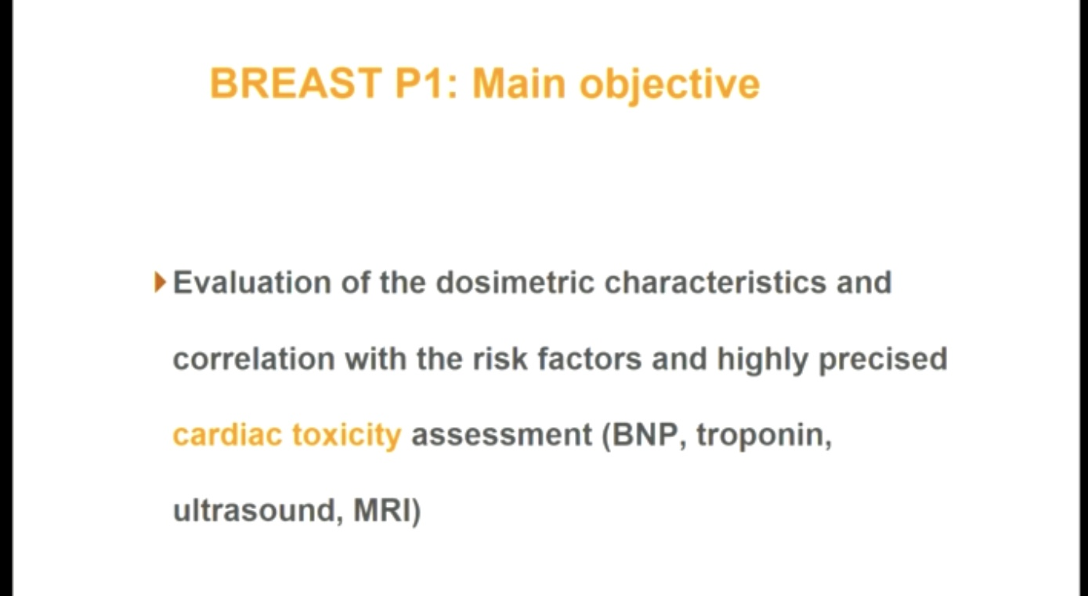

Slide 69
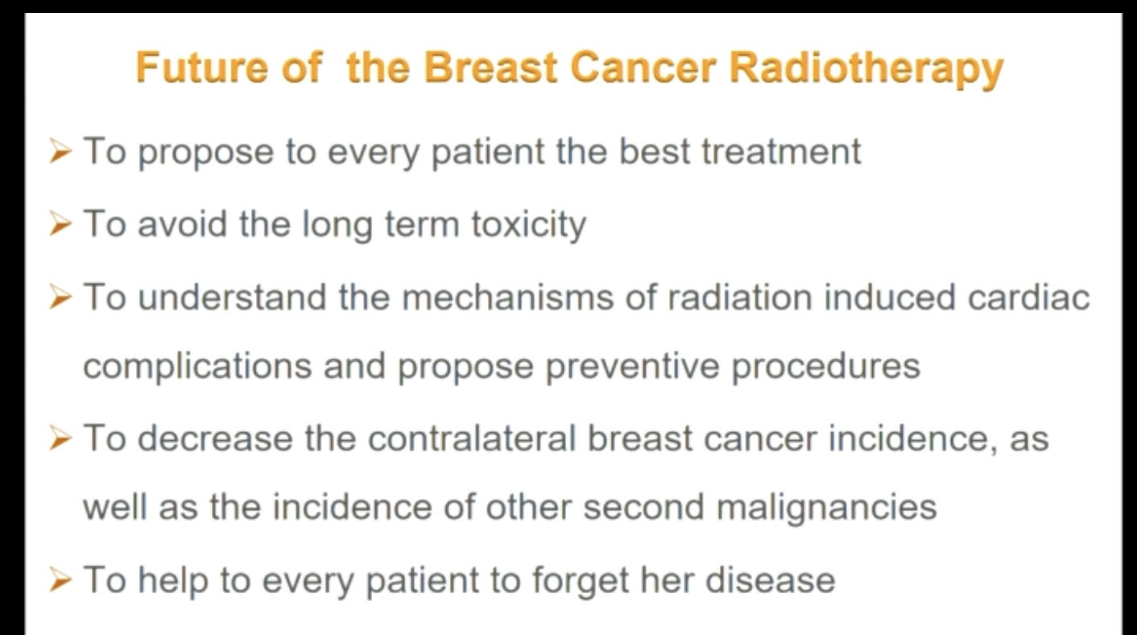

Slide 70
thanks
Dr Abdulla Alhasso (Lead clinician)
The wonderful oncology team at the Beatson Cancer centre

Slide 71
Multidisciplinary approach is essential
We do not have randomised clinical trial data for every situation,
When data is lacking for guidelines, expert opinion is helpful
Inform patients on options

Slide 72
Thank you for your attention

Slide 73
